Slide 1
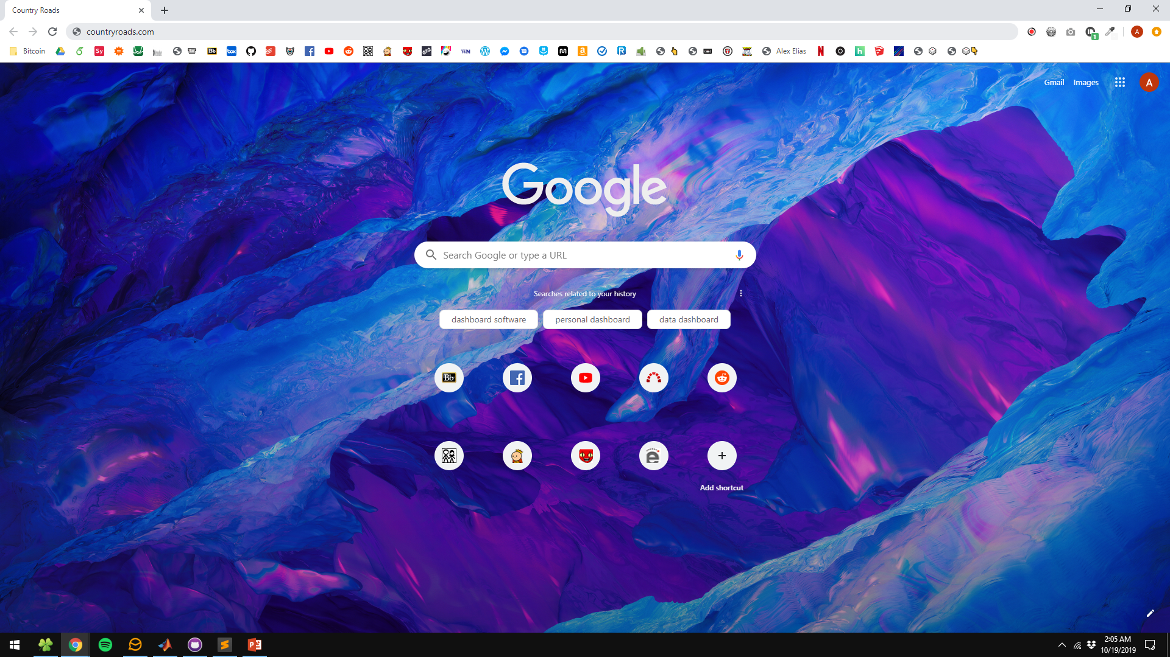
Country Roads
Take me home

